Slide 1
Sampling Theorem
Expt. No- 7

Slide 2
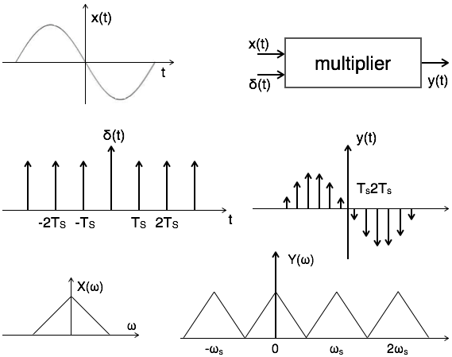
Theory:

Slide 3
Statement:
A continuous time signal can be represented in its samples and can be recovered back when sampling frequency fs is greater than or equal to the twice the highest frequency component of message signal. i. e.
fs≥2fm.

Slide 4
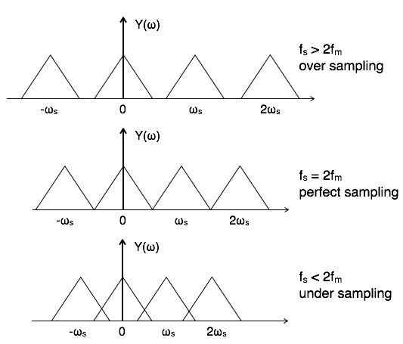
Theory:

Slide 5
MATLAB Code:
%sampling
close all;
clc;
t=0:0.01:1; % Time Vector
fm=10; % Message (Input) signal amplitude
Am=1; % (Input) signal amplitude

Slide 6
MATLAB Code:
x=Am*sin(2*pi*fm*t); % Message signal
subplot(2,2,1);
plot(t,x,'linewidth',2);
xlabel('time');
ylabel('amplitude');
grid;
title('Message input signal');

Slide 7
MATLAB Code:
n1=-5:1:5;
fs1=1.6*fm;
fs2=2*fm;
fs3=8*fm;
x1=Am*cos(2*pi*fm/fs1*n1);
subplot(2,2,2);
stem(n1,x1,'linewidth',3);
xlabel('number of samples');
ylabel('amplitude');
grid on;
title('under sampling');

Slide 8
MATLAB Code:
n2=-5:1:5;
x2=cos(2*pi*fm/fs2*n2);
subplot(2,2,3);
stem(n2,x2,'linewidth',3);
xlabel('number of samples’);
ylabel('amplitude');
hold on;
title('uniform sampling');

Slide 9
MATLAB Code:
n3=-20:1:20;
x3=cos(2*pi*fm/fs3*n3);
subplot(2,2,4);stem(n3,x3,'linewidth',3);
hold on;
xlabel('number of samples');
ylabel('amplitude');
grid;
title('over sampling');

Slide 10
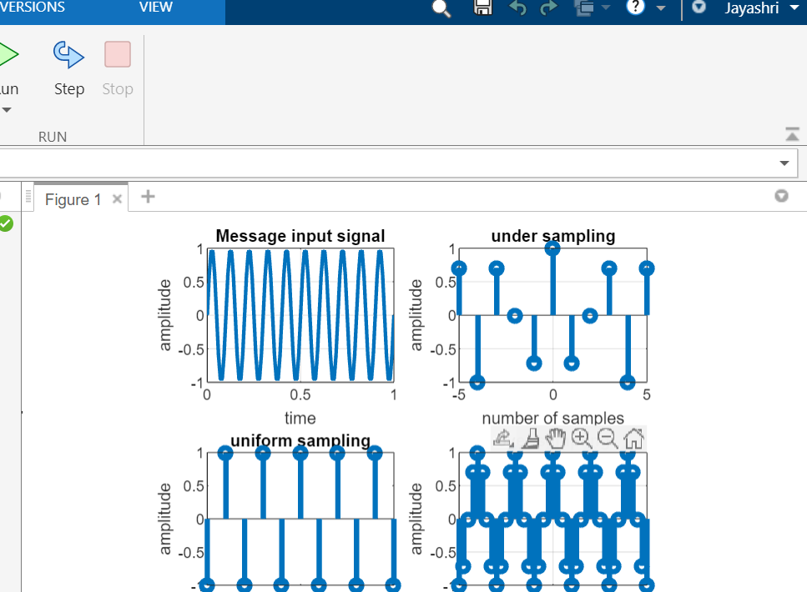
Output:

Slide 11
References:
[1]https://www.tutorialspoint.com/signals_and_systems/signals_sampling_theorem.htm
[2] https://www.youtube.com/watch?v=km7VQfWrrw0

